Slide 1


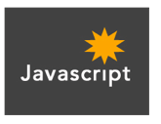

PHP Programming By: MANSOOR AHMED (P15-6069)
1

Slide 2
PHP Introduction
PHP is a recursive acronym for “PHP: Hypertext Preprocessor” -- It is a widely-used open source general-purpose scripting language that is especially suited for web development and can be embedded into HTML.
Note: PHP started to be know as Personal Home Page. Then later adding to have Hypertext preprocessor as its other name, so now it’s “PHP: Hypertext Preprocessor”

Slide 3
PHP Introduction
> PHP is a server-side scripting language
> PHP scripts are executed on the server
> PHP supports many databases (MySQL, Informix, Oracle, Sybase, Solid, PostgreSQL, Generic ODBC, etc.)
> PHP is open source software
> PHP is free to download and use

Slide 4
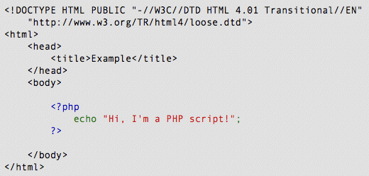
PHP Introduction

Slide 5
PHP Introduction
PHP code is executed on the server, generating HTML which is then sent to the client. The client would receive the results of running that script, but would not know what the underlying code was.
A visual, if you please...

Slide 6
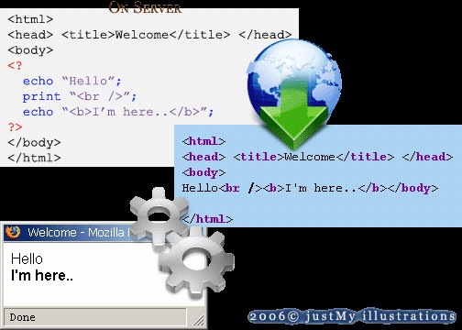
PHP Introduction

Slide 7
PHP Getting Started
On windows, you can download and install XAMPP . With one installation and you get an Apache webserver, database server and php. http://www.apachefriends.org/en/xampp.html
This can be installed to most of the well known OS in the industry. Linux and Mac(UNIX) is included.

Slide 8
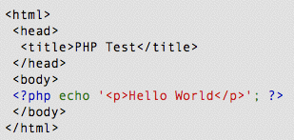
PHP Hello World
Above is the PHP source code.

Slide 9
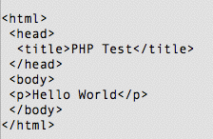
PHP Hello World
It renders as HTML that looks like this:

Slide 10
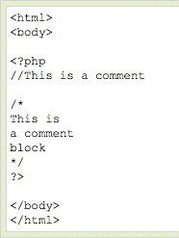
PHP Comments
In PHP, we use // to make a single-line comment or /
* and */ to make a large
comment block.

Slide 11

PHP Variables
> Variables are used for storing values, like text strings, numbers or arrays.
> When a variable is declared, it can be used over and over again in your script.
> All variables in PHP start with a $ sign symbol.
> The correct way of declaring a variable in PHP:

Slide 12

PHP Variables
> In PHP, a variable does not need to be declared before adding a value to it.
> In the example above, you see that you do not have to tell PHP which data type the variable is.
> PHP automatically converts the variable to the correct data type, depending on its value.

Slide 13
PHP Variables
> A variable name must start with a letter or an underscore "_" -- not a number
> A variable name can only contain alpha-numeric characters, underscores (a-z, A-Z, 0-9, and _ )
> A variable name should not contain spaces. If a variable name is more than one word, it should be separated with an underscore ($my_string) or with capitalization ($myString)

Slide 14

PHP Concatenation
> The concatenation operator (.) is used to put two string values together.
> To concatenate two string variables together, use the concatenation operator:

Slide 15

PHP Concatenation
The output of the code on the last slide will be:
If we look at the code you see that we used the concatenation operator two times. This is because we had to insert a third string (a space character), to separate the two strings.

Slide 16
PHP Operators
Operators are used to operate on values. There are four classifications of operators:
> Arithmetic
> Assignment
> Comparison
> Logical

Slide 17
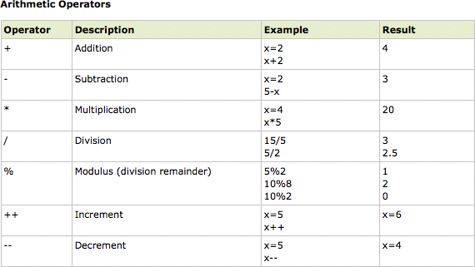
PHP Operators

Slide 18
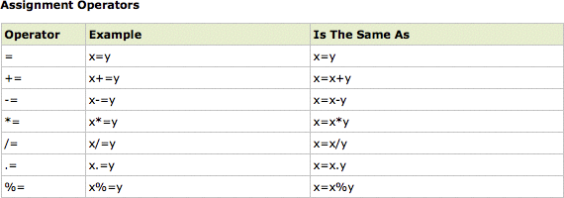
PHP Operators

Slide 19
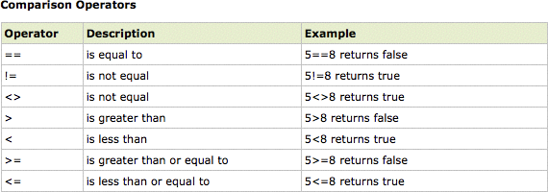
PHP Operators

Slide 20
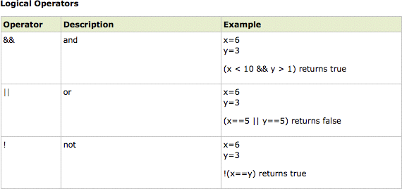
PHP Operators

Slide 21
PHP Conditional Statements
> if statement - use this statement to execute some code only if a specified condition is true
> if...else statement - use this statement to execute some code if a condition is true and another code if the condition is false
> if...elseif....else statement - use this statement to select one of several blocks of code to be executed
> switch statement - use this statement to select one of many blocks of code to be executed

Slide 22
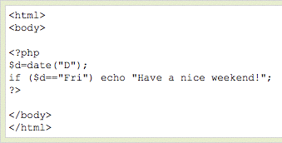
The following example will output "Have a nice weekend!" if the current day is Friday:

Slide 23
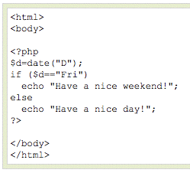
Use the if....else statement to execute some code if a condition is true and another code if a condition is false.

Slide 24
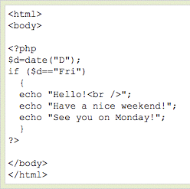
PHP Conditional Statements
If more than one line should be executed if a condition is true/false, the lines should be enclosed within curly braces { }

Slide 25
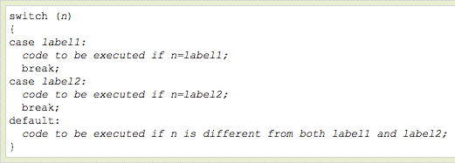
Use the switch statement to select one of many blocks of code to be executed.

Slide 26
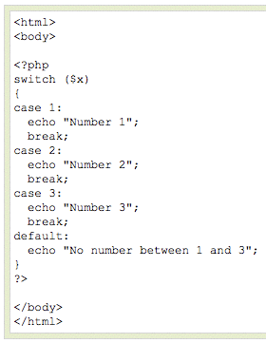
PHP Conditional Statements
ming - Timothy Bryan Marc

Slide 27
PHP Arrays
> An array variable is a storage area holding a number or text. The problem is, a variable will hold only one value.
> An array is a special variable, which can store multiple values in one single variable.

Slide 28

PHP Arrays
If you have a list of items (a list of car names, for example), storing the cars in single variables could look like this:

Slide 29
PHP Arrays
In PHP, there are three kind of arrays:
> Numeric array - An array with a numeric index
> Associative array - An array where each ID key is associated with a value
> Multidimensional array - An array containing one or more arrays

Slide 30
PHP Numeric Arrays
> A numeric array stores each array element with a numeric index.
> There are two methods to create a numeric array.

Slide 31


PHP Numeric Arrays
In the following example the index is automatically assigned (the index starts at 0):
In the following example we assign the index manually:

Slide 32
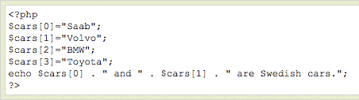

PHP Numeric Arrays
In the following example you access the variable values by referring to the array name and index:
The code above will output:

Slide 33
PHP Associative Arrays
> With an associative array, each ID key is associated with a value.
> When storing data about specific named values, a numerical array is not always the best way to do it.
> With associative arrays we can use the values as keys and assign values to them.

Slide 34

PHP Associative Arrays
In this example we use an array to assign ages to the different persons:
This example is the same as the one above, but shows a different way of creating the array:

Slide 35
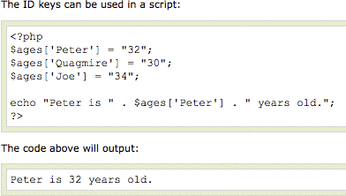
PHP Associative Arrays

Slide 36
PHP Multidimensional Arrays
In a multidimensional array, each element in the main array can also be an array.
And each element in the sub-array can be an array, and so on.

Slide 37
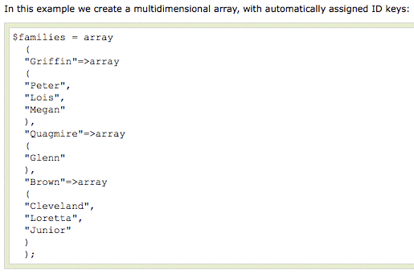
PHP Multidimensional Arrays

Slide 38
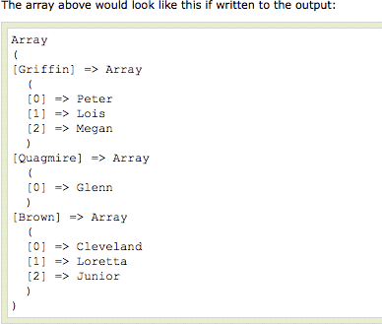
PHP Multidimensional Arrays

Slide 39
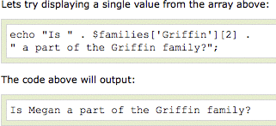
PHP Multidimensional Arrays

Slide 40
PHP Loops
> Often when you write code, you want the same block of code to run over and over again in a row. Instead of adding several almost equal lines in a script we can use loops to perform a task like this.
> In PHP, we have the following looping statements:

Slide 41
PHP Loops
> while - loops through a block of code while a specified condition is true
> do...while - loops through a block of code once, and then repeats the loop as long as a specified condition is true
> for - loops through a block of code a specified number of times
> foreach - loops through a block of code for each element in an array

Slide 42
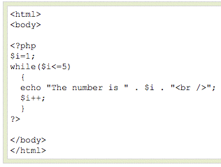
PHP Loops - While
The while loop executes a block of code while a condition is true. The example below defines a loop that starts with
i=1. The loop will
continue to run as long as i is less than, or equal to 5. i will increase by 1 each time the loop runs:

Slide 43
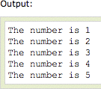
PHP Loops - While

Slide 44
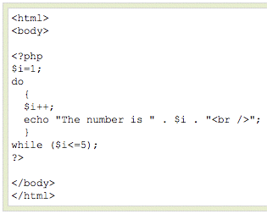
PHP Loops – Do ... While

Slide 45
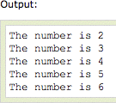
PHP Loops – Do ... While

Slide 46
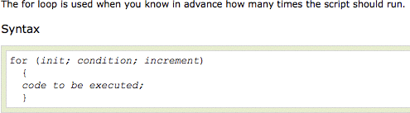
PHP Loops - For

Slide 47
PHP Loops - For
Parameters:
> init: Mostly used to set a counter (but can be any code to be executed once at the beginning of the loop)
> condition: Evaluated for each loop iteration. If it evaluates to TRUE, the loop continues. If it evaluates to FALSE, the loop ends.
> increment: Mostly used to increment a counter (but can be any code to be executed at the end of the loop)

Slide 48
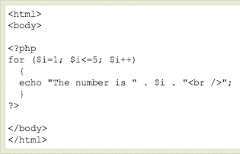
PHP Loops - For
The example below defines a loop that starts with i=1. The loop will continue to run as long as i is less than, or equal to 5. i will increase by 1 each time the loop runs:

Slide 49
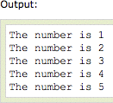
PHP Loops - For

Slide 50

PHP Loops - Foreach
For every loop iteration, the value of the current array element is assigned to $value (and the array pointer is moved by one) - so on the next loop iteration, you'll be looking at the next array value.

Slide 51
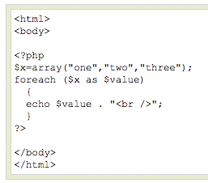
PHP Loops - Foreach
The following example demonstrates a loop that will print the values of the given array:

Slide 52

PHP Loops - Foreach

Slide 53
PHP Functions
> We will now explore how to create your own functions.
> To keep the script from being executed when the page loads, you can put it into a function.
> A function will be executed by a call to the function.
> You may call a function from anywhere within a page.

Slide 54

PHP Functions
A function will be executed by a call to the function.
> Give the function a name that reflects what the function does
> The function name can start with a letter or
underscore (not a number)

Slide 55
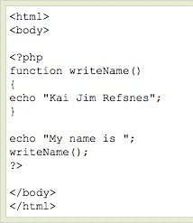
PHP Functions
A simple function that writes a name when it is called:

Slide 56
PHP Functions - Parameters
Adding parameters...
> To add more functionality to a function, we can add parameters. A parameter is just like a variable.
> Parameters are specified after the function name, inside the parentheses.

Slide 57
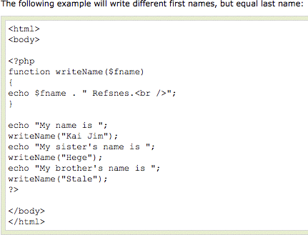
PHP Functions - Parameters

Slide 58

PHP Functions - Parameters

Slide 59
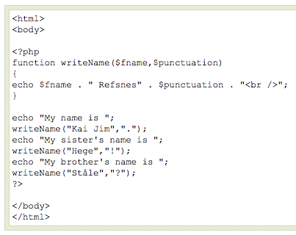
PHP Functions - Parameters
This example adds different punctuation.

Slide 60

PHP Functions - Parameters

Slide 61
PHP Forms - $_GET Function
> The built-in $_GET function is used to collect values from a form sent with method="get".
> Information sent from a form with the GET method is visible to everyone (it will be displayed in the browser's address bar) and has limits on the amount of information to send (max. 100 characters).

Slide 62


PHP Forms - $_GET Function
Notice how the URL carries the information after the file name.

Slide 63
PHP Forms - $_GET Function
The "welcome.php" file can now use the $_GET function to collect form data (the names of the form fields will automatically be the keys in the
$_GET array)

Slide 64
PHP Forms - $_GET Function
> When using method="get" in HTML forms, all variable names and values are displayed in the URL.
> This method should not be used when sending passwords or other sensitive information!
> However, because the variables are displayed in the URL, it is possible to bookmark the page. This can be useful in some cases.
> The get method is not suitable for large variable values; the value cannot exceed 100 chars.

Slide 65
PHP Forms - $_POST Function
> The built-in $_POST function is used to collect values from a form sent with method="post".
> Information sent from a form with the POST method is invisible to others and has no limits on the amount of information to send.
> Note: However, there is an 8 Mb max size for the POST method, by default (can be changed by setting the post_max_size in the php.ini file).

Slide 66

PHP Forms - $_POST Function

Slide 67
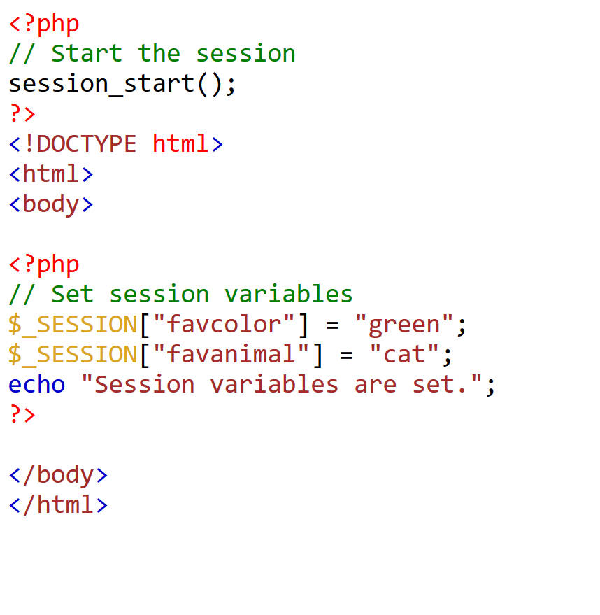
Session

Slide 68
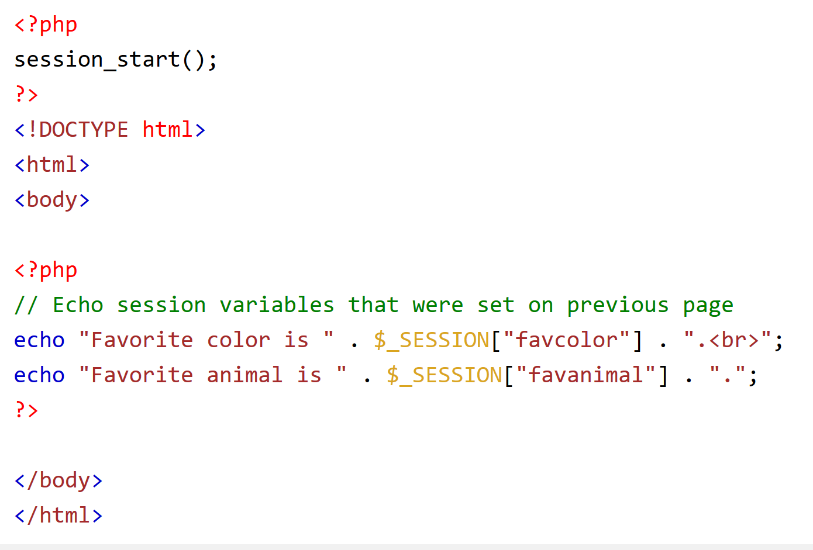
Session

Slide 69
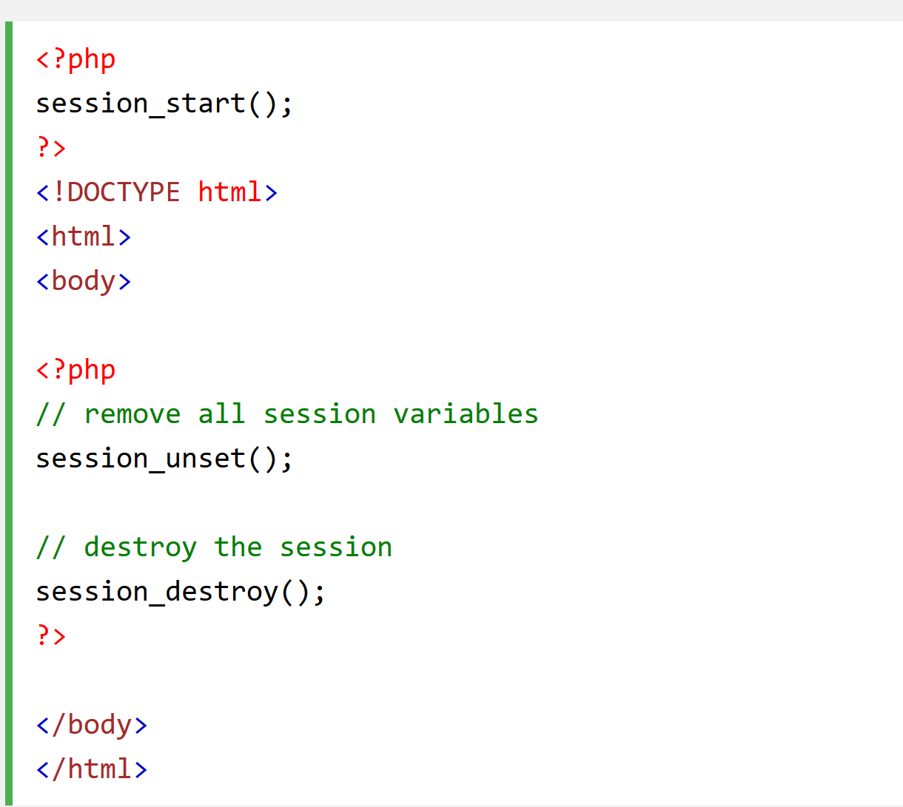
Session Destroy

Slide 70
End of Lesson
Thank You
Mail me at: P156069@gmail.com, P156069@nu.edu.pk

